Slide 1
How to Produce a News Package
Josh Dempsey
Media Education Foundation of Georgia

Slide 2
News Package
A news package is fully-edited video story
PKGS are complete productions with:
B-roll & graphics
NAT sound
Reporter track
SOTs
Introduced by the show’s anchor (lead in)
Concluded by anchor with a tag

Slide 3
Purpose
NOT a Hit Piece
We don’t tell stories about the ant problem in the cafeteria.
PR Tool
We do tell stories about how a science class collected ants from the cafeteria and used them to create an ant farm for academic purposes.
If we don’t brag on “us”, who will?
Notes:
Not a hit piece on someone or something about the school. Never.
It is a public relations tool that we use to make our school, our district, and MOST IMPORTANTLY this program look good.
usemaked to make our school, this district, and most importantly this program look good

Slide 4
Stories matter,
but stories about
matter more.
people

Slide 6
Process
Find the Story
Shoot the Story
Write the Story
Edit the Story

Slide 7
Find the Story
Talk to someone and tell their story
Ask department leaders for upcoming events
Email teachers and beg for ideas
See what students are doing in other classes
Check school calendars
Search social media
Make a national story local
Walk around campus and look at posters

Slide 8
Shoot the Story - Gear
Tripod
Camera
Recording media
Microphone
Headphones
Light
Notes:
Tripods are the easiest way to tell a professional from an amatuer.
You can shoot with any type of camera from a cell phone to a DSLR, but the best camera will allow you to focus quickly and record audio directly into the camera.
Always check to make sure that you have something to record onto, whether it is internal memory or a card, make sure you have it and make sure it works.
Microphones are vital to news storytelling. If you cannot hear the subject talking, you might as well not tell the story. A wireless lav is preferred, but anything that is not built into the camera will be best.
You have to hear what the camera hears, so wear headphones. Don’t trust your audio levels on the screen.
Light… don’t use it and see what happens. Use it, and you’ll never shoot without it again.

Slide 9
Shoot the Story - Process
Determine order of the event
Begin shooting
Wide
Medium
Tight
Put the story together in your mind
Interview subjects
Authorities
Interesting others
Notes:
Grab a program if possible. Talk to someone if no order of service exists.
Wide shots are used for establish the scene and orienting the viewer to what is happening in the story and where.
Medium shots are great for most things, especially interviews.
Tight shots are great for showing detail, and most importantly emotion.
If you start writing the story in your mind, you will be able to capture shots that help to tell that story.
When you do interviews, be sure to shoot with depth in the shot. Do not shoot against a flat background.

Slide 10
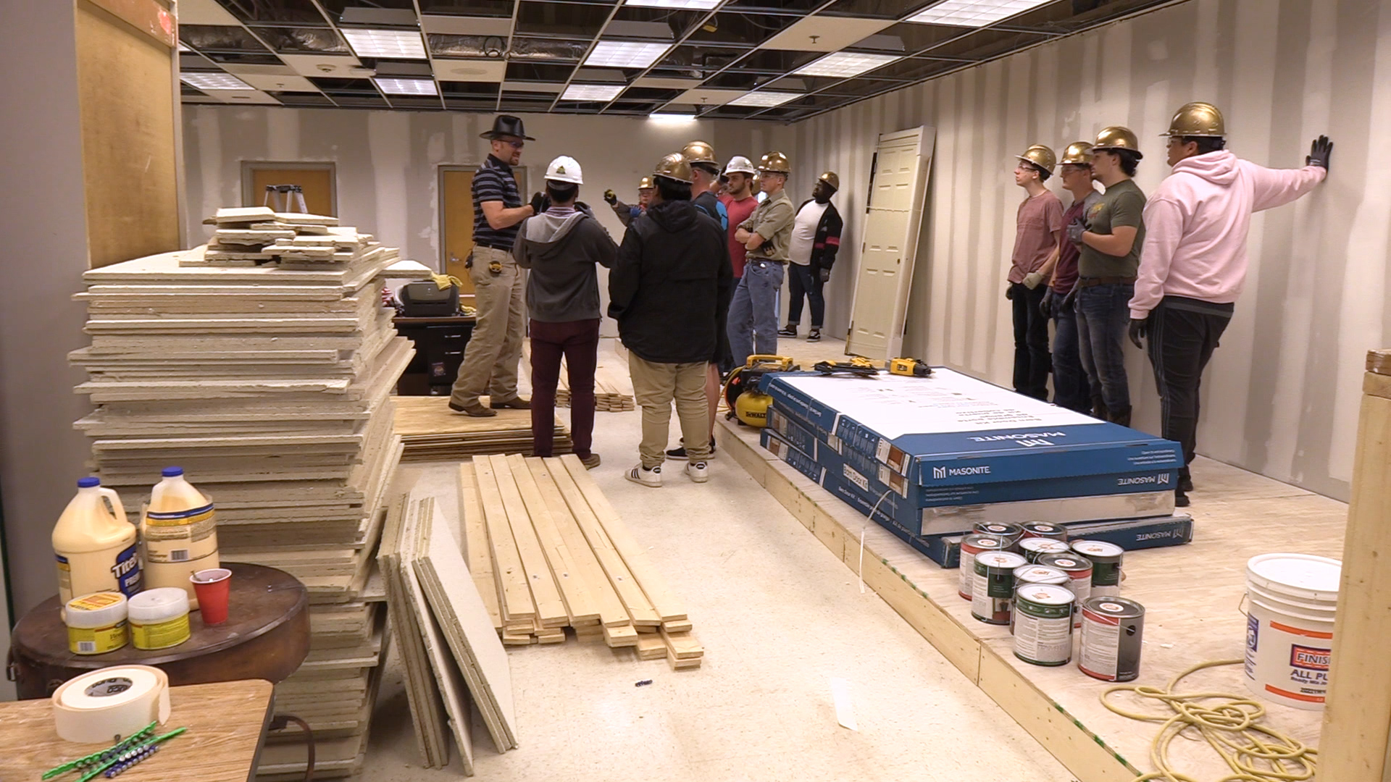
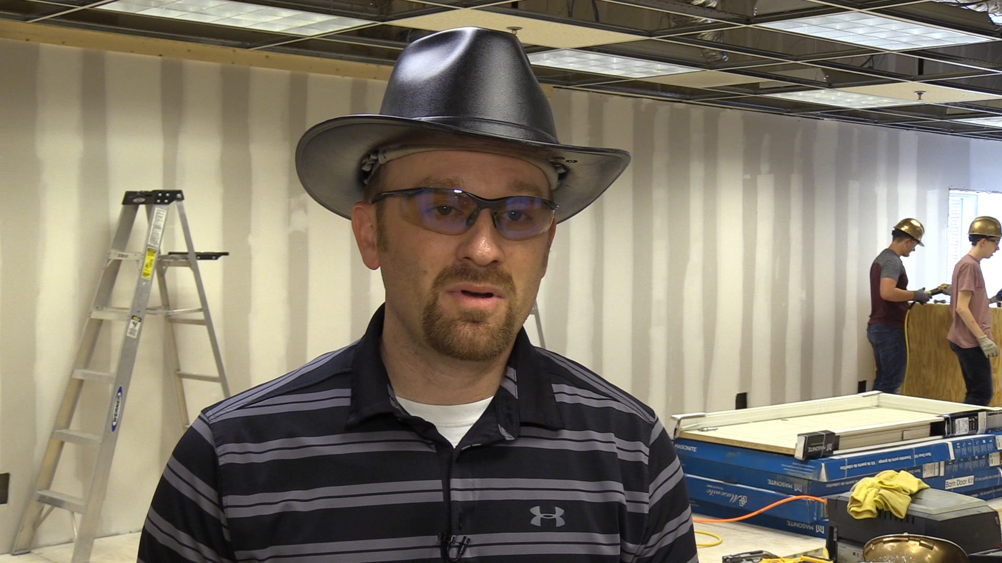
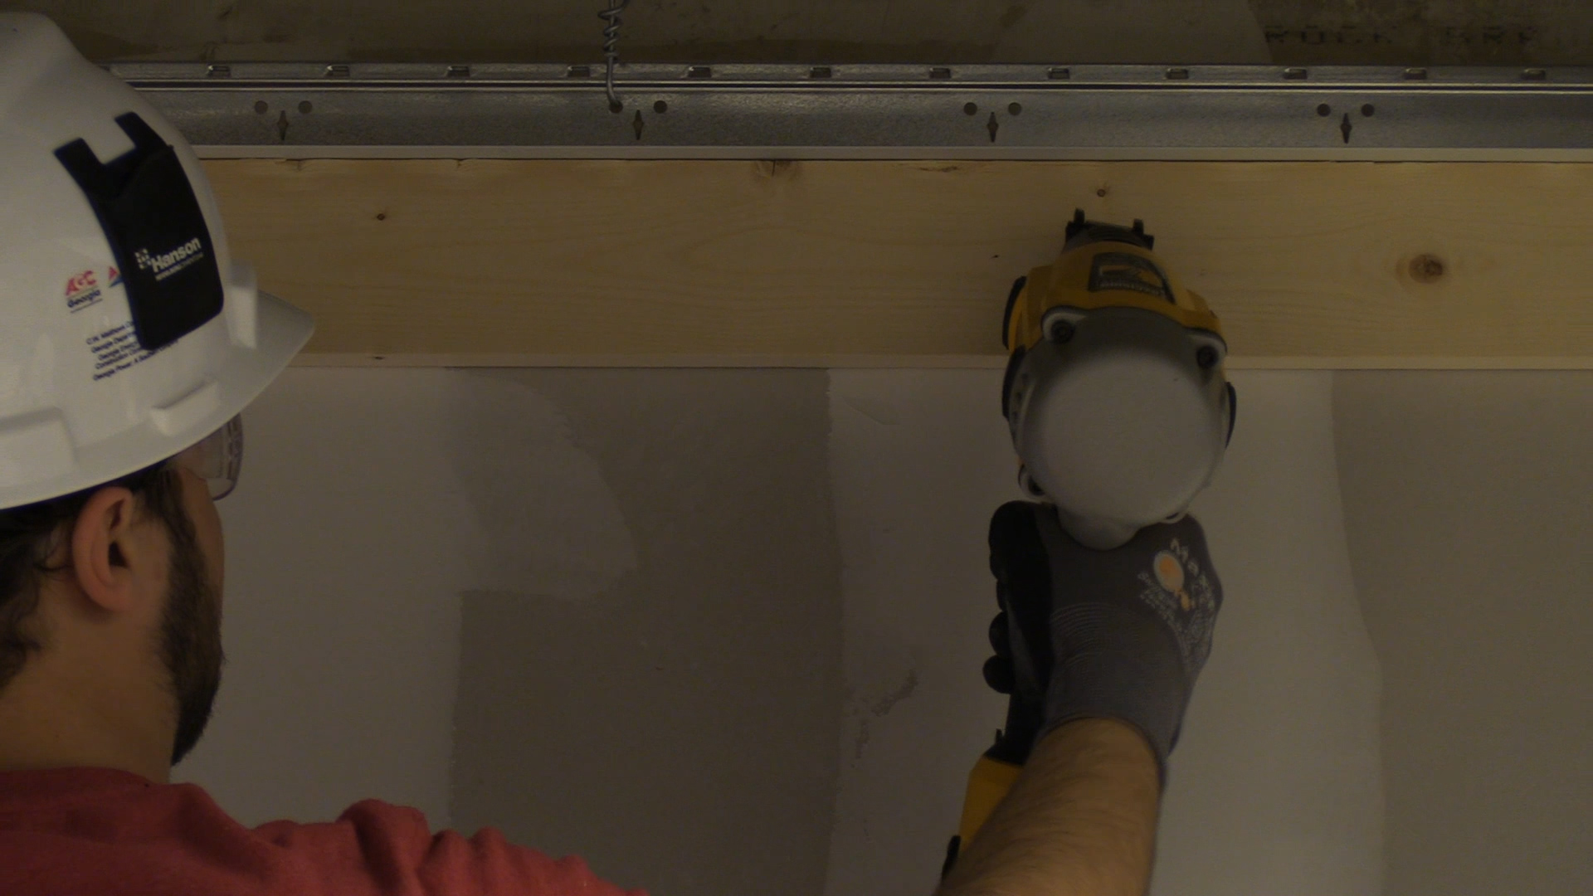
Wide Shot
This type of shot is used to establish the setting and to orient viewers to the action in the story.
Medium Shot
This type of shot is the most common in a story, and is the most neutral. It just showcases what was happening and doesn’t impact viewer perception.
Close Up Shot
Close ups are used to provide detail and, most importantly, to convey emotion to the audience.

Slide 11
Write the Story
Listen to AND transcribe your interviews
Delete the ones that aren’t as important
Write into and out of your soundbites
Try to start with NATS to bring the audience in
If you can write around NATs, do it
Don’t forget your “sig out”
Notes:
Remember, this is not your story. Let the people connected to it tell it. Use the soundbites.
You cannot save all of your babies. You have a limited time to tell the story, so choose the best of what you’re given and get rid of the rest.
The other soundbites do give you information though, so use them to write your track.
Set us your soundbites when possible. This will help with the flow of your story and make the whole piece more engaging.
NATs are soooo important. Too many times younger producers will just delete the NATS and opt for a music bed - don’t do this unless necessary.
Your signature out should be consistent from one reporter to the next. For example, “For Blue Devil News, I’m Josh Dempsey.”

Slide 12
Notes:
This story begins with NATs, which in this case is actually the subject, mic’d up, talking to his students. It was a key statement about the program, and needed to be included.
The first VO introduces Jeremy and establishes that he is a teacher - specifically a construction teacher. But it says even more than that.
The first SOT tells what the story is about.
The second VO plays off of construction.
The second SOT is from an authority adding credence to what Jeremy is doing in the classroom.

Slide 13
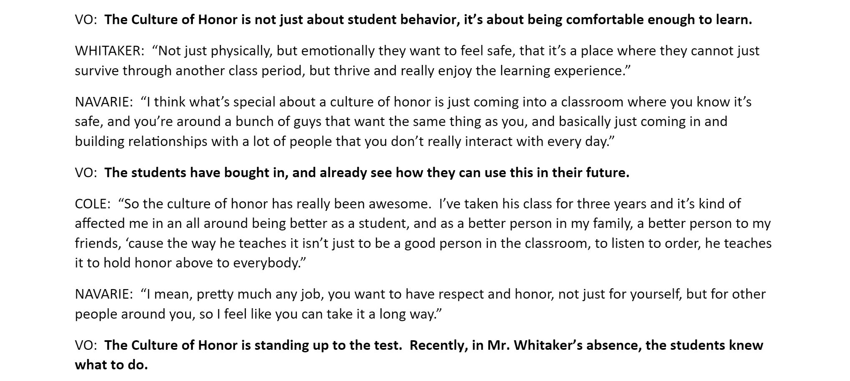
Notes:
The VO sets up the soundbites, and leads in smoothly…
The second SOT, from Navarie, echoes and expands on the bite before it.
The second VO is short, as they always should be, but still sets up the next bite.
Again, Navarie’s bite is an echo of the one before, but sums up the importance of the program.
The next VO leads into an example of the Culture of Honor in practice.

Slide 14
Click here to see the whole script.
Notes:
Jeremy’s SOT reinforces the value of the program, and tells it is a succinct story.
The last VO tries to tie everything up neatly.
The “sig out” is a consistent way to brand your programming.

Slide 15
Edit the Story
Record the reporter track
Lay down the audio first
Color in your video with the b-roll
Do a split edit!!!!!!
Try to add NATs when possible
Add branded titles last
Notes:
Use your best microphone in your quietest location.
Start with opening NATs and work your way through the audio.
Be sure to add a multiband compressor AND normalize each clip to zero (individually).
It is important to use multiple layers when editing your video. If you have one long, straight line, you have a bad video.
Sound is as, or more, important as video so make the most of your natural sound clips. This starts with shooting, so don’t jack up your video by talking during the shots.

Slide 16
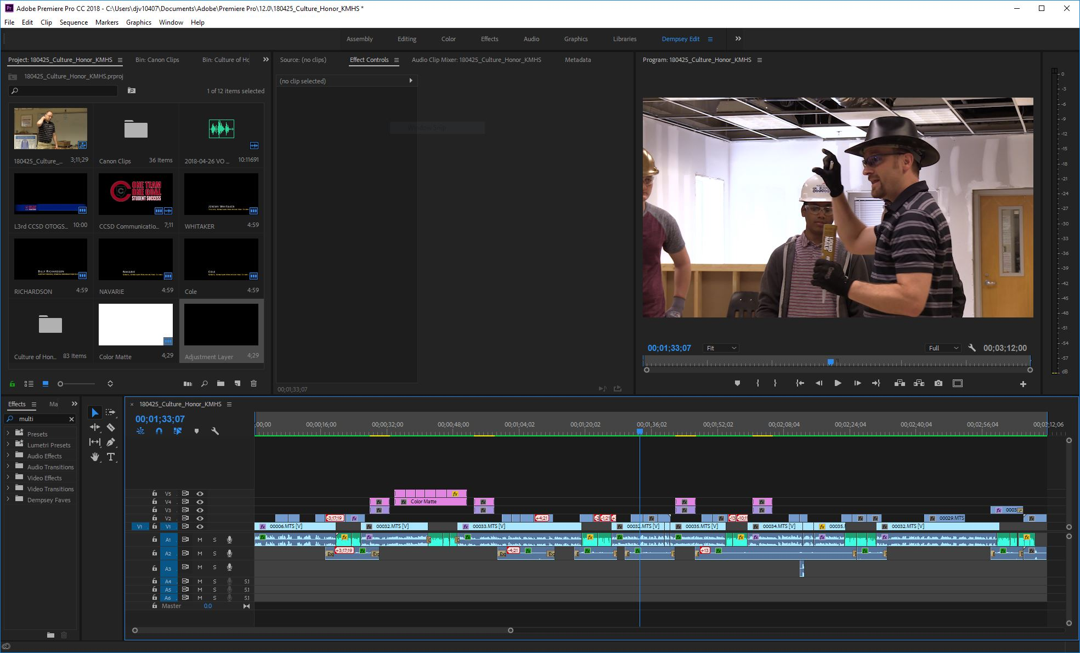

Slide 17
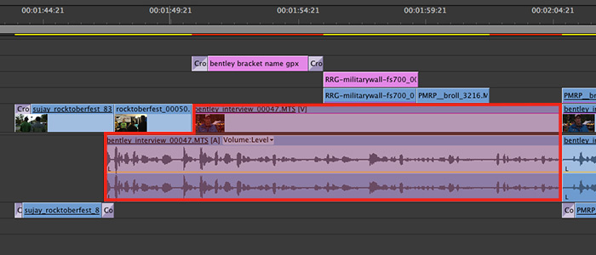
J-Cuts get their name from the shape they make when editing. It allows you to hear something before you actually see the accompanying video. This adds continuity and smoothness to your production.

Slide 18
Our Objective
●Produce a 1:30-2:00 news package
●Must have:
○Reporter track
○At least two SOTs
○B-roll
○NATs
○Lower-thirds
●Will air tomorrow morning during meeting
●If you can share the script and all video, we can use that in our classes

Slide 19
Terms
News Package (PKG): a fully edited news story that includes all elements of production, usually introduced by the anchor in studio
B-Roll: video that helps to tell your story visually, that does not include interviews
Graphics: visual elements of a production that are produced in a computer, not shot with the camera; this can include maps, titles, etc.

Slide 20
Terms
NAT Sound: the “natural” sound captured while shooting video; this sound is crucial to telling the story
Reporter Track: the narration of a news package that was written and recorded by the person telling the story
SOTs: “sounds on tape” refers to the interviews used in the news story; also known as bites or soundbites

Slide 21
Terms
Anchor: the face of a newscast, usually located in the studio; all stories go through the news anchor
Sig Out: signature outtro; the verbal stamp on the end of your news story
Lead In: the portion of a news story that is spoken on camera by the anchor that sets up the package

Slide 22
Terms
Tag: the portion of the story that follows the package and spoken on camera by the anchor; it usually adds information or where to find more information
Split Edit: a video editing technique that allows for audio and video tracks to be edited independent of each other, allowing for continuity and smoothness in the production

